Slide 1
Equity in action
Get beyond admiring the problem
Tara Richerson, Tumwater SD
AWSP/WASA Summer Conference
June 27, 2016

Slide 2
Agenda
Create meaningful plans of action
Admire the right problem
Equity in communication and access
You are here

Slide 3

Equity issues through a data lens
What are your questions?
What can you offer or share?
What are your struggles with data use?
How are you balancing external demands for compliance with internal needs for action?
CC-BY https://www.flickr.com/photos/eddi_07/4610841659/

Slide 4
Are we admiring
the right problem?

Slide 5
What is disproportionality?
Proportionality exists when the percent of incidents, such as suspensions, equals the percent enrolled in the group.
If boys are 40% of enrollment, they should be no more than 40% of suspensions.
40 are boys
If you suspend 20 students, 16 of whom are boys, this is disproportional.
100 students

Slide 6
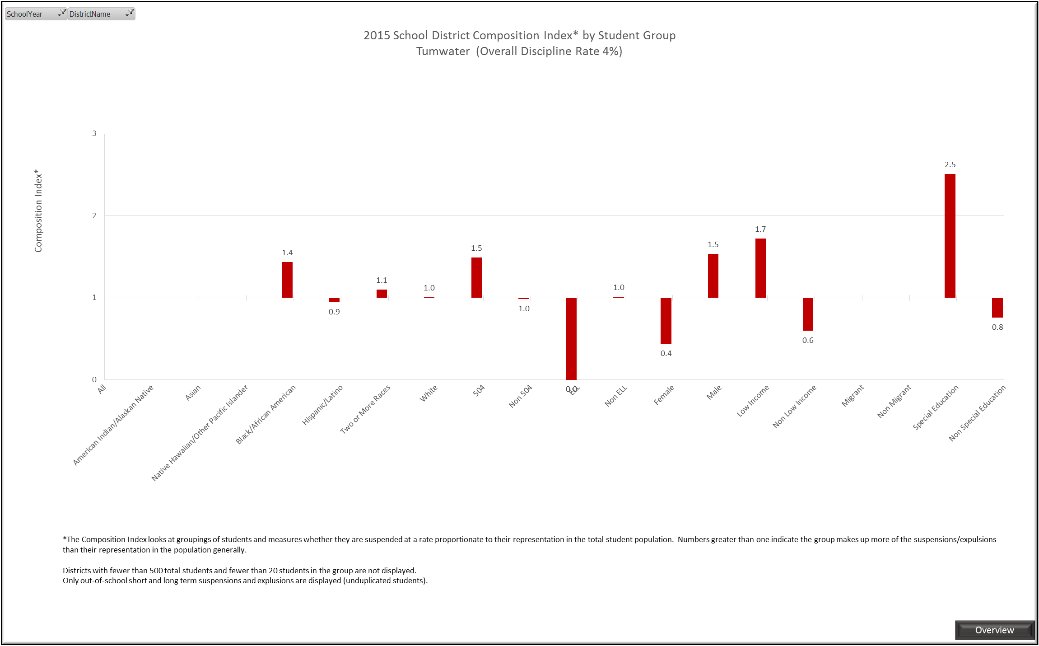
State data release: Discipline

Slide 7
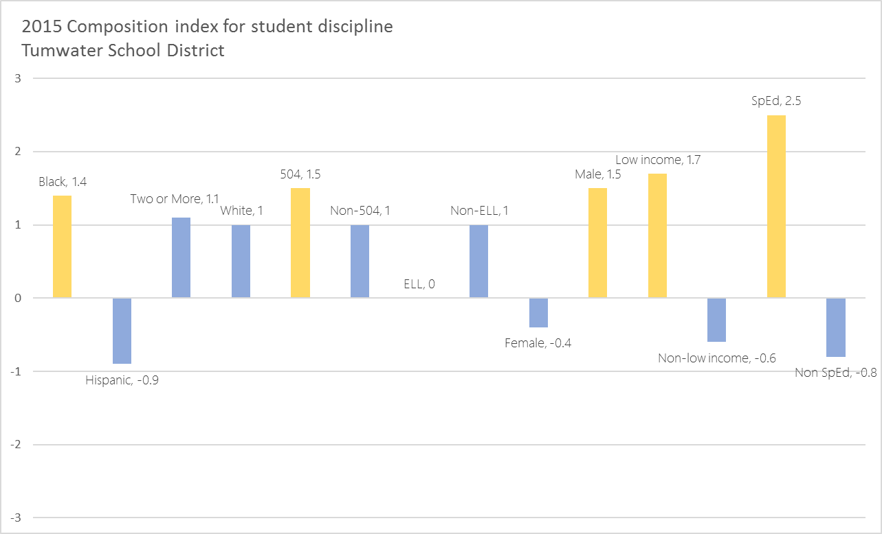
Discipline redux

Slide 8
Discipline redux
Percent of population
Female
2014 percent suspended
Male
2015 percent suspended
GenEd
SpEd
Low income
Non low income

Slide 9
Make connections
Relationship between sixth grade student performance on the state ELA exam and incidents resulting in suspension or expulsion.
L1
L2
L3
L4

Slide 10
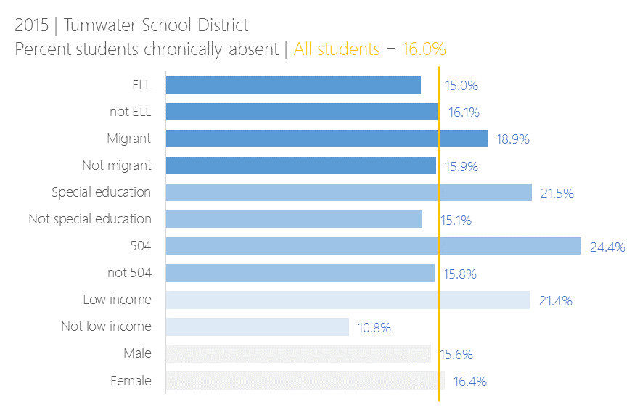
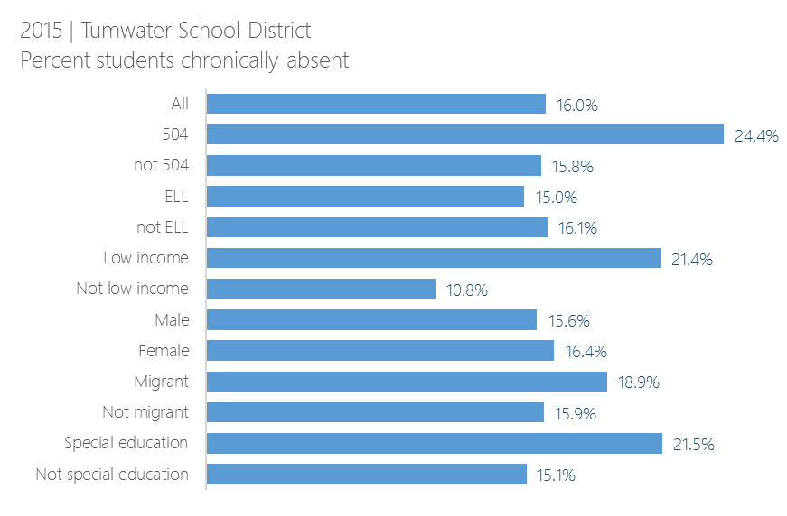
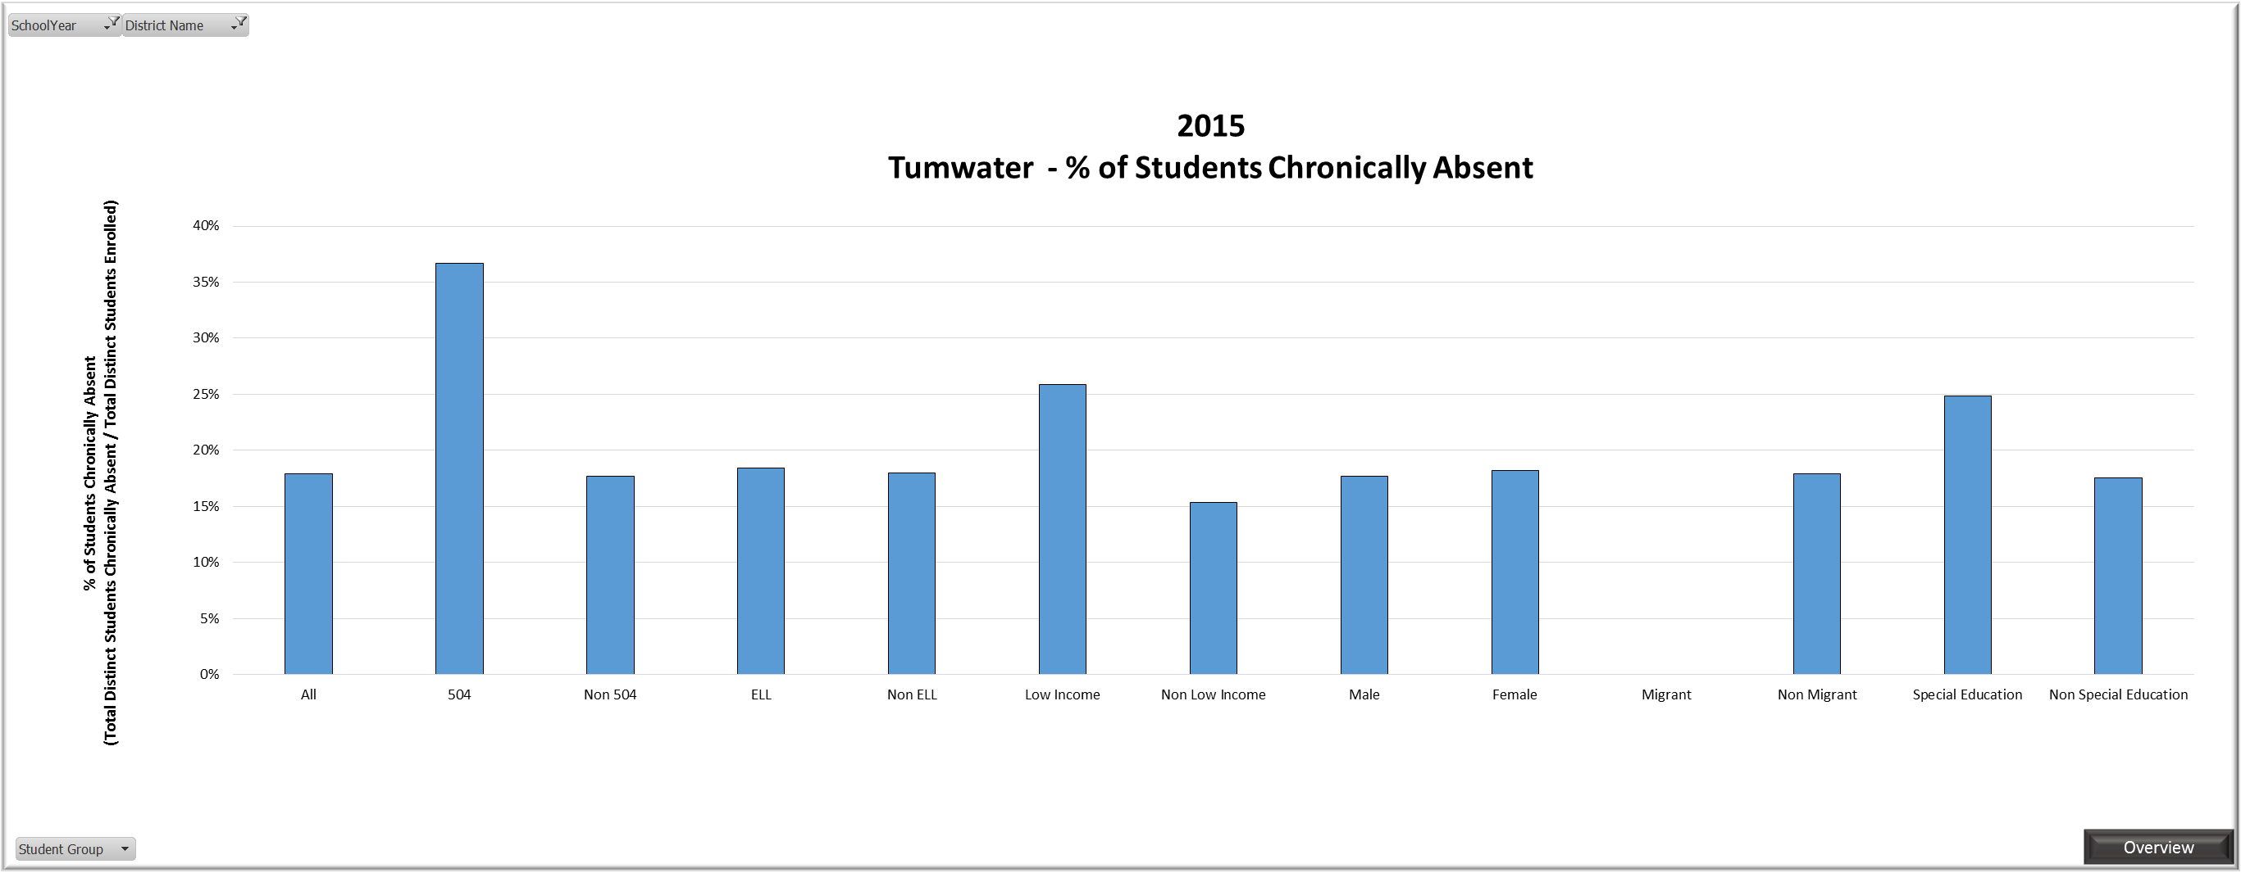
State data release: Chronic absence

Slide 11
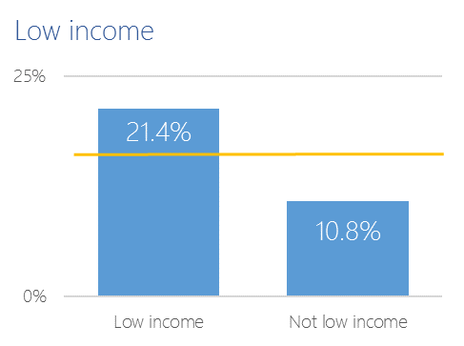
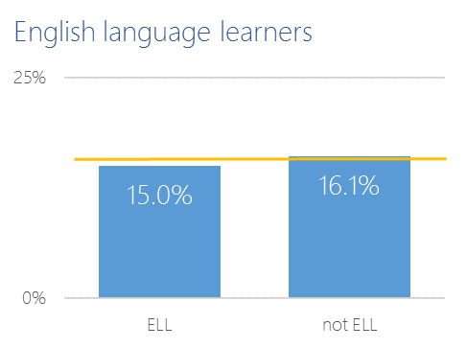
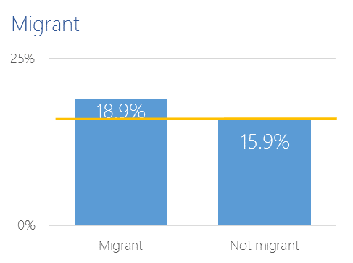
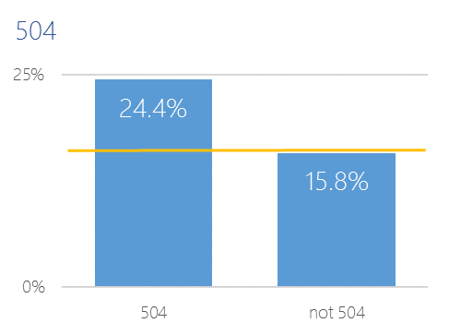
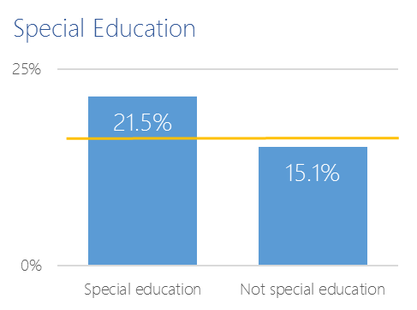
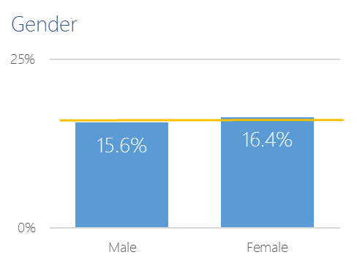
State data release: Chronic absence

Slide 12
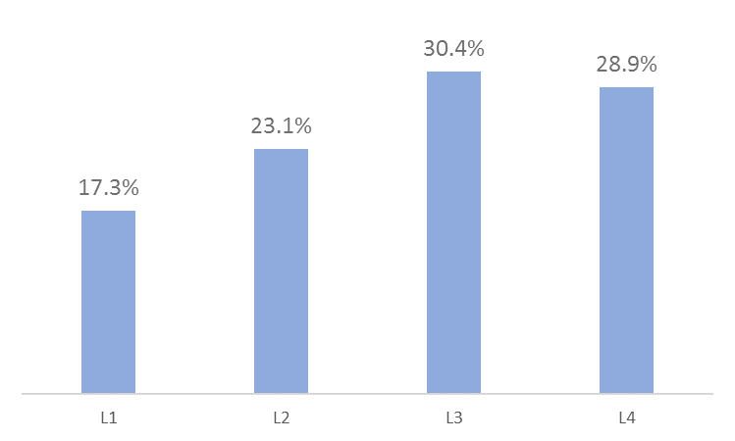
Distribution of scores
Grade 3 performance on 2015 ELA SBAC
n = 69

Slide 13
Distribution of scores
50%
40%
32%
20%
8%
0%
Level 1
Level 2
Level 3
Level 4

Slide 14
Gender
50%
40%
32%
20%
8%
0%
Level 1
Level 2
Level 3
Level 4

Slide 15
Free or reduced lunch
50%
40%
32%
20%
8%
0%
Level 1
Level 2
Level 3
Level 4

Slide 16
White
50%
40%
32%
20%
8%
0%
Level 1
Level 2
Level 3
Level 4

Slide 17
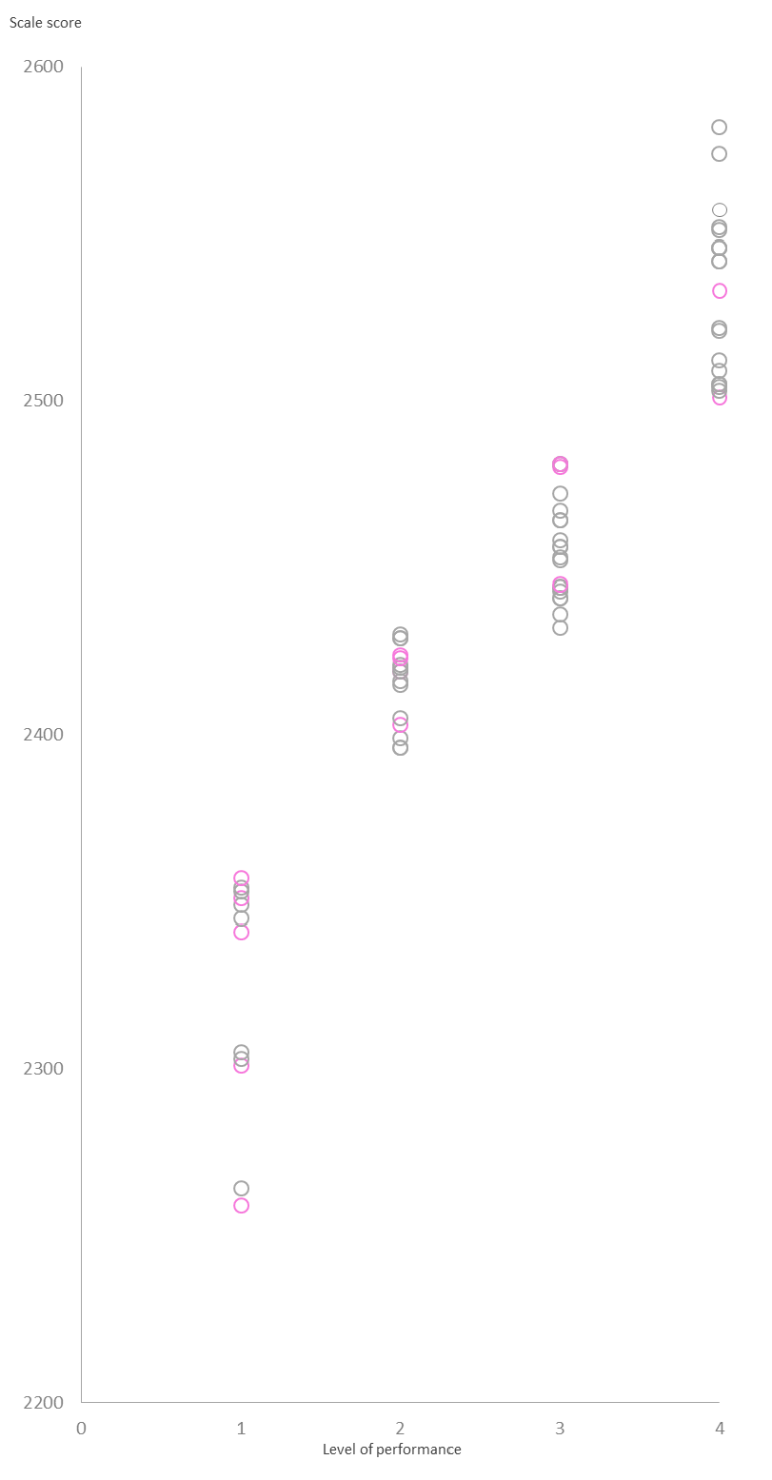
Distribution of scores
Grade 3 performance on 2015 ELA SBAC
n = 69
Every third grade student is represented by a circle.
Approximately 66% of white students met the standards compared to 34% of students of color.

Slide 18
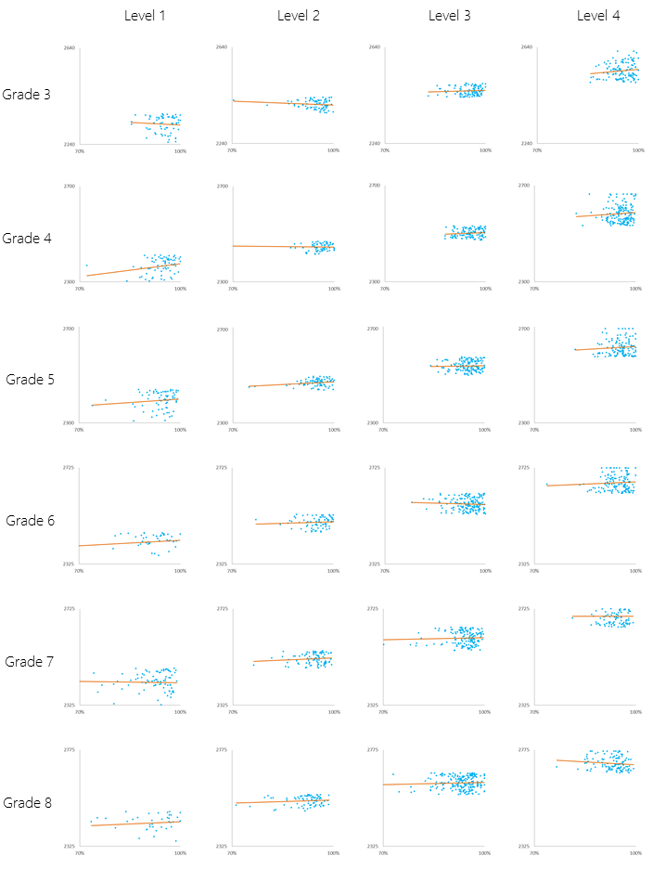
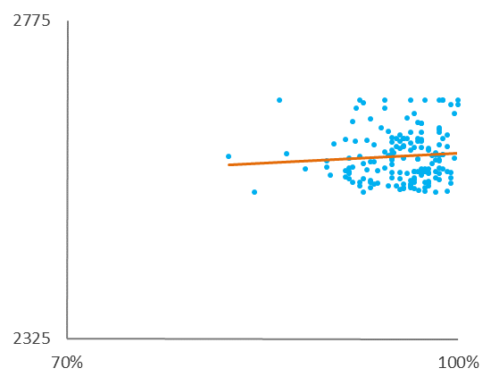
Does attendance influence achievement?
Every dot represents a student.
Line of best fit
Small multiples enable simultaneous comparison among groups to observe patterns.
Scale for SBAC ELA
Percent days attended

Slide 19
Are we admiring the right problem?
1
How are you identifying questions about equity in your school or district?
2
What data stories do you use to promote inquiry in your school or district about equity?

Slide 20
Take action

Slide 21
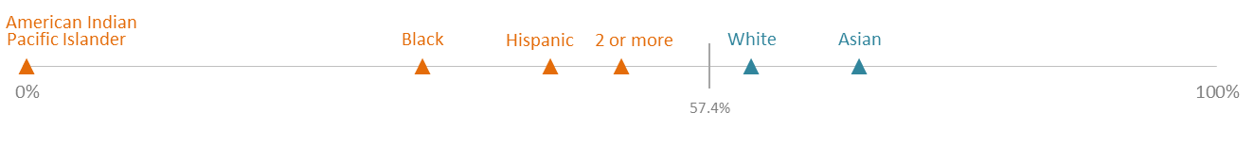
Achievement gap
Tumwater School District | Grade 3
2015 English Language Arts
n = 431 | 57.4% met standard
Gender
Ethnicity
Special Education
Income
1
2
Let’s look at math!
Let’s look at more grade levels!

Slide 22
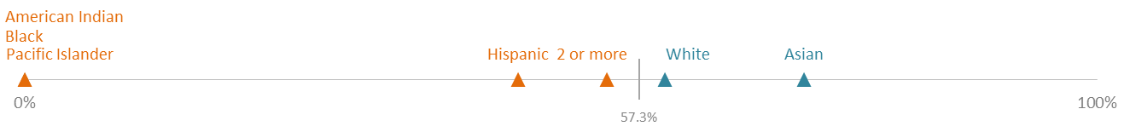
Grade 3 math
Tumwater School District | Grade 3
2015 Mathematics
n = 428 | 57.3% met standard
Gender
Ethnicity
Special Education
Income
Problem statement

Slide 23
Grades 3 – 8 SpEd ELA
Tumwater School District | Grades 3 - 8
2015 ELA
Grade 3
Grade 4
Grade 5
Grade 6
Grade 7
Grade 8
Problem statement

Slide 24
Problem statement
Based on the data you have reviewed, write a problem statement that
identifies the group affected, and
your inference(s) from the data.
For example…
The gap between low-income and non low-income students is unchanged between grade levels and content areas.

Slide 25
Next steps
What would you like to learn?
1
Generate ideas about possible causes
20 reasons
2
Describe a relationship between possible causes
Fishbone
3
Reach consensus about which cause is most important
Why, why, why

Slide 26
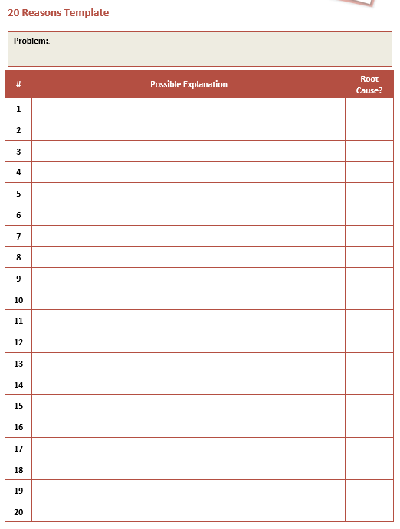
20 reasons
1
Brainstorm reasons why the problem is happening.
Write each on a sticky note.
2
Share ideas, but don’t judge them. We’re brainstorming!
3
Identify ideas which are related.
Problem of Practice

Slide 27
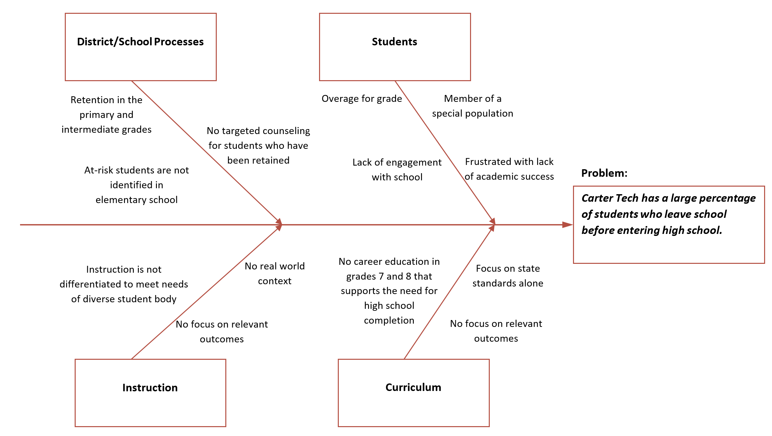
Fishbone
1
Write the problem statement.
2
Brainstorm categories related to the problem and place them in the boxes.
3
Elaborate by adding possible causes to the “ribs” for each category.
Problem of Practice

Slide 28
Why, why, why
1
Brainstorm reasons why the problem is happening.
Write each on a sticky note.
Problem statement
Why might this be happening?
Reason
Possible explanation
2
Rank order ,sticky notes by level of plausibility.
plausibility
3
State a possible explanation for the most plausible cause.
Problem of Practice

Slide 29
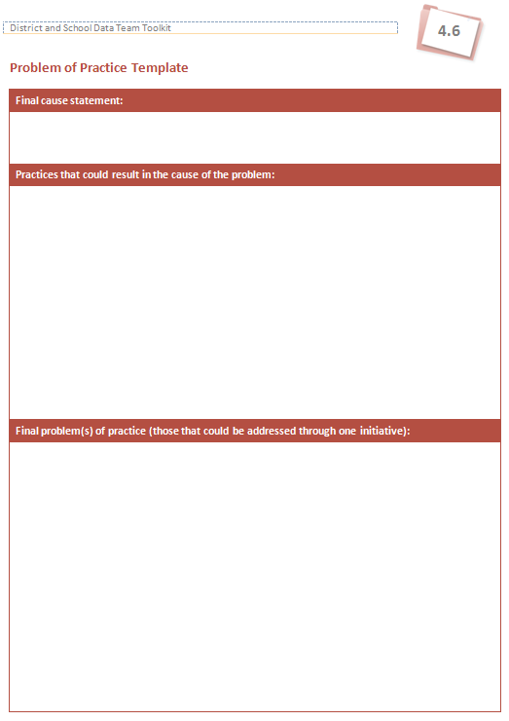
Problem of practice
1
Write a statement about your root cause. Then, record the other supporting causes.
2
Create a statement which captures a problem of practice that could address the root cause.

Slide 30
Next steps
What would you like to learn?
1
Identify the most likely root cause of the problem
Interrelationships
2
Focus on high-leverage causes for action plans
Significance and control
3
Illustrate a connection between interventions and outcomes
Develop a logic model

Slide 31
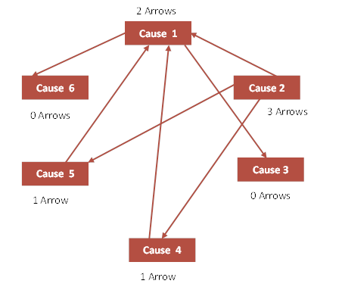
Cluster maps: Interrelationships
1
Place your sticky notes on a piece of chart paper.
2
Draw arrows between them to show how one cause influences an other.
You do not have to connect them all.
Draw the arrow toward a sticky note if it is influenced by something else.
The cause with the most arrowheads going away from it is the root cause.
Summary

Slide 32
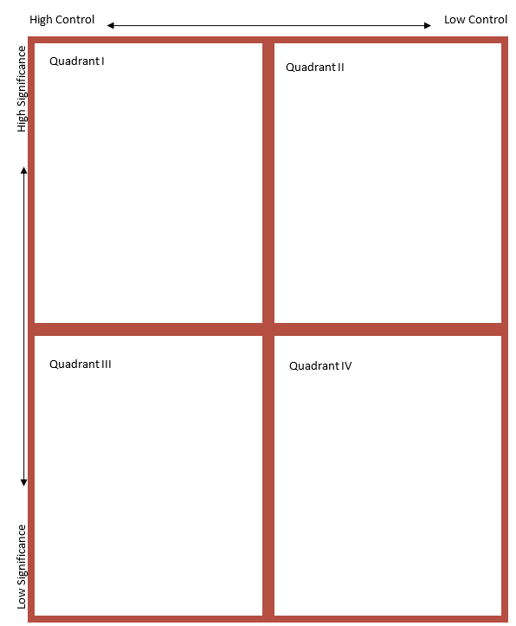
Significance and control
Brainstorm reasons why the problem exists and write each on a sticky note.
1
2
Place each sticky note on the chart at the intersection of significance and control.
Summary

Slide 33
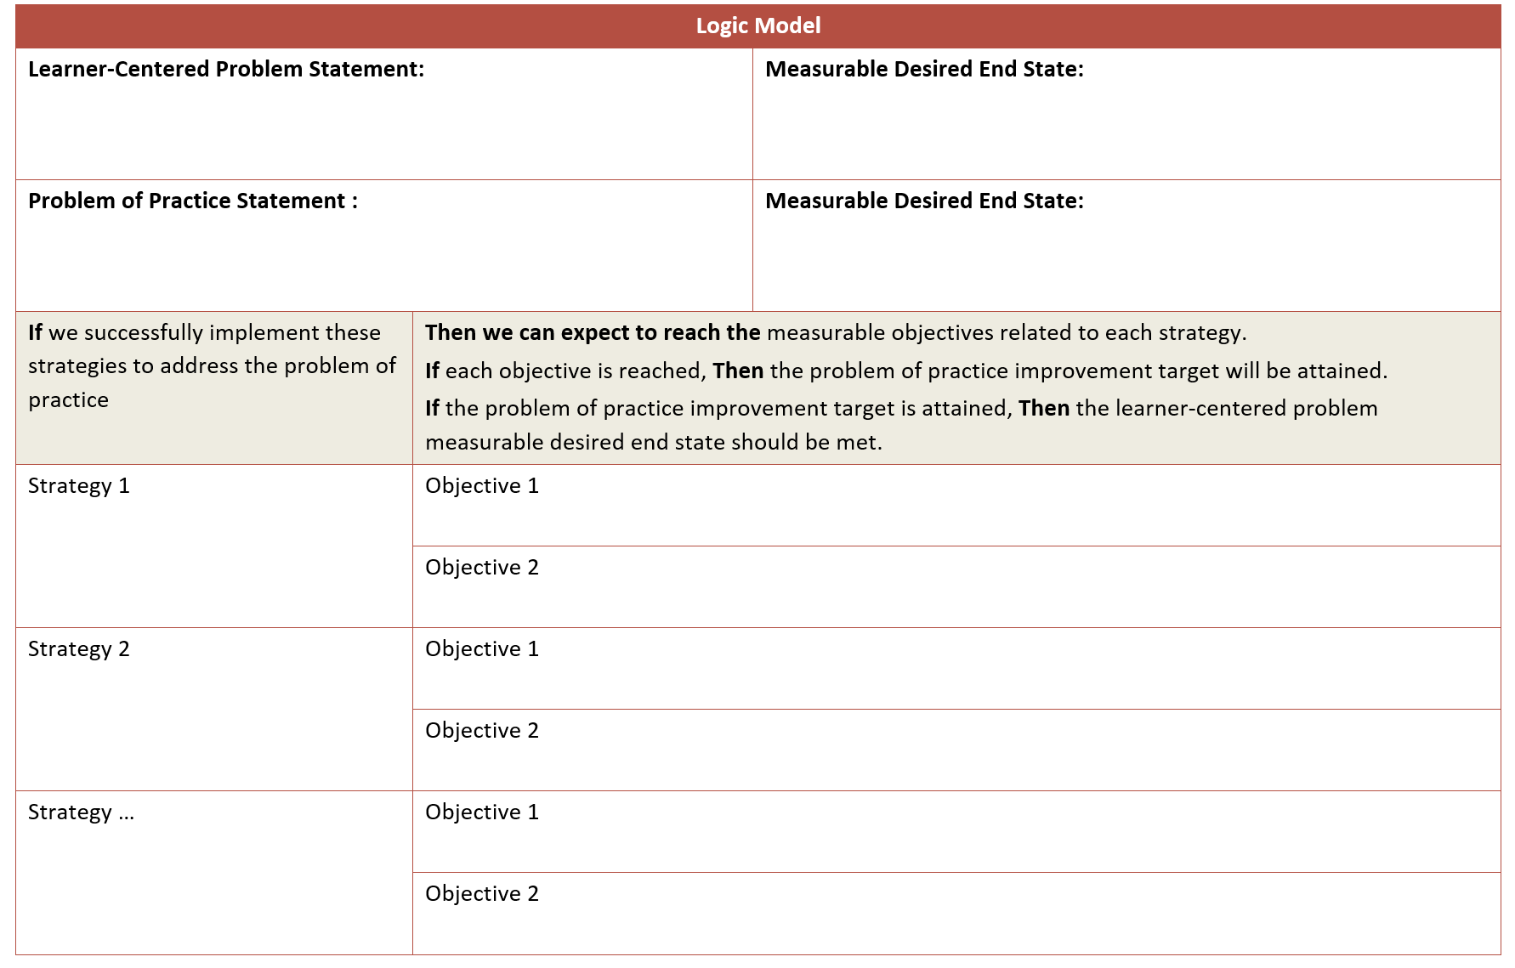
Logic model
Identify at least one end state (or SMART goal) related to the problem.
1
Identify a strategy that will help achieve the goal or end state.
2
If we create a community group focused on collective impact, then basic needs will be met for more families, and then more low-income students will graduate.
3
Write an if-then statement which connects the problem, strategy, and end state.
Summary

Slide 34
Take action
1
What tools or strategies support your school or district in addressing problems?
2
What is your most pressing problem of practice?

Slide 35
Equity is more
than student barriers

Slide 36

When you use data to study people, ask Who gains power with this information?
If it’s not the people whose data you are using, there’s a problem.
─Hilary Mason
cc-nd-nc-by Christopher Penn https://www.flickr.com/photos/financialaidpodcast/2287769216/

Slide 37
Ethics in data use
What are our responsibilities with the data?
How do stakeholders, including students, provide feedback about or review the data we collect?
How do we communicate uncertainty or missing data points?
What are the roles of process, culture, or bias in developing data stories?

Slide 38
Closure
and next steps

Slide 39
Agenda review
Create meaningful plans of action
Admire the right problem
Equity in communication and access
You are here

Slide 40
Closure
My big takeaway from this session is ____.
When I go home, I want to have a conversation with ____ about ____.

Slide 41
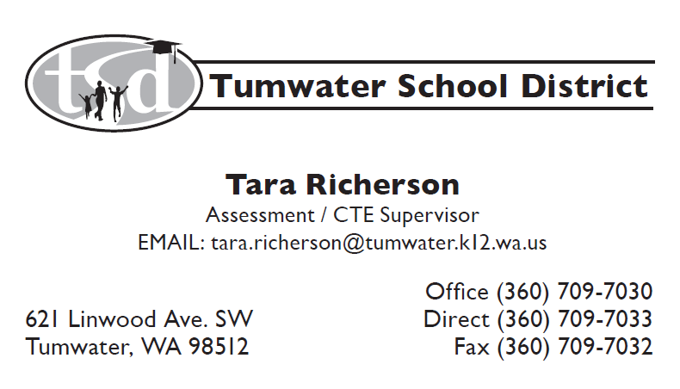
Data Pedant

